Slide 1


Slide 2
Smart Social Event Miner
Supervisor: Dr. Mohammad Asif
Presented By:
Nabeel Zafar & Rizwan Ali

Slide 3
Introduction
The term “smart social event Miner” encompasses every user of the Facebook
who uses Facebook to report real-life events .
So this system which is for Facebook provides major activities for the event detection posted in Facebook.

Slide 4
Motivation
Our supervisor give the idea about this project and motivate us to work on it
Today, online social networking services like Twitter, Facebook play an important role in the dissemination of information in a real-time basis.
We read different articles about social media and get motivated for this project

Slide 5
Problem Statement
Most of the described approaches to solve the event detection in text streams are not real-time
Finally today computation time is an issue.
In most cases using this kind of systems it is preferable to have an immediate and approximated solution rather than waiting too much for an exact solution.
Given this “Smart social event miner” the approach to deal with this specific problem involves providing solutions that are able to mine continuous, high-volume, open-ended data streams as they

Slide 6
Development..
Tools
Apache Cordova platform which is the cross platform
We use this platform for different operating system
We use HTML5

Slide 7
Ionic Framework
Ionic is a complete open-source SDK for hybrid mobile app development. Built on top of AngularJS and Apache Cordova, Ionic provides tools and services for developing hybrid mobile apps using Web technologies like CSS, HTML5, and Sass.

Slide 8
Current Status
Proposal submitted
SRS completed
Design ready
Database connectivity Continue…

Slide 9
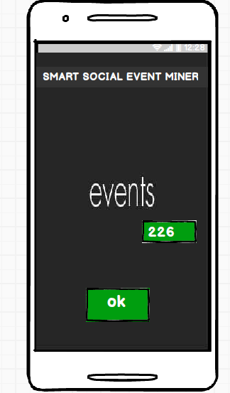
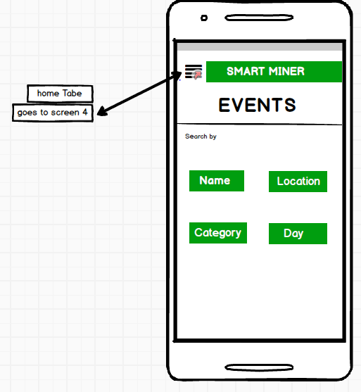
Screen shots
Screen Short

Slide 10
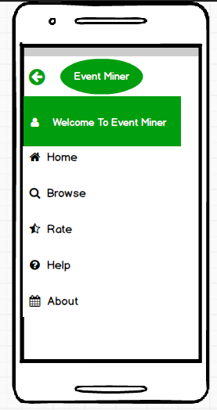
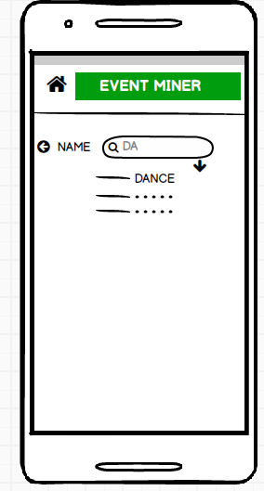
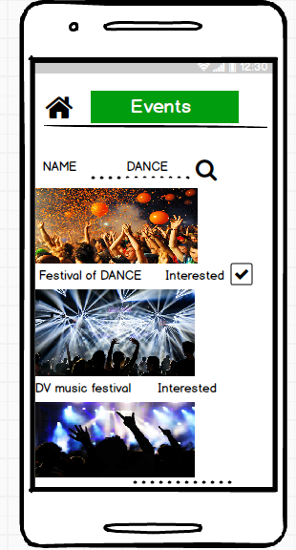
Screen Shots

Slide 11
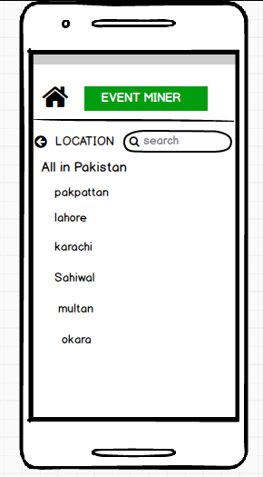
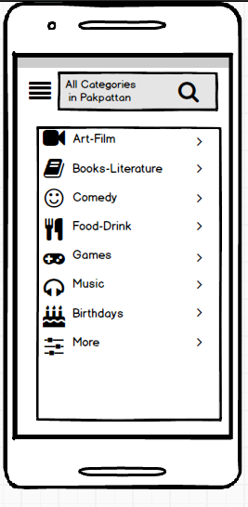
Screen shots

Slide 12
Diagrams

Slide 13
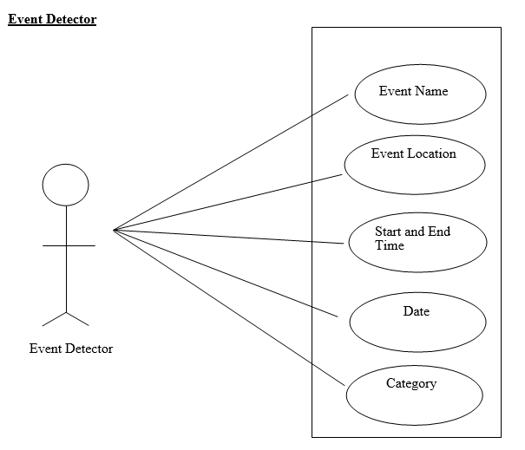
Use cases

Slide 14
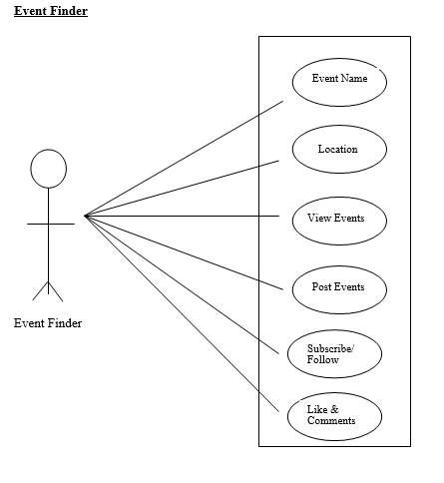
Continue…

Slide 15
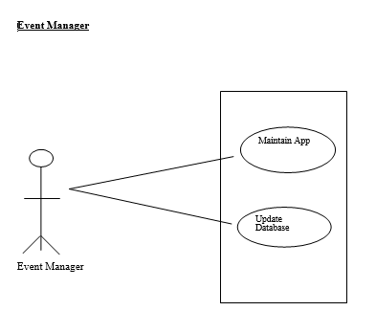
Continue…

Slide 16
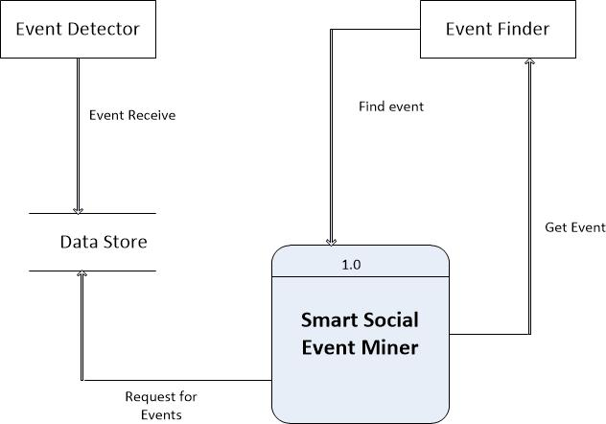
Data Flow Diagram 0 level

Slide 17
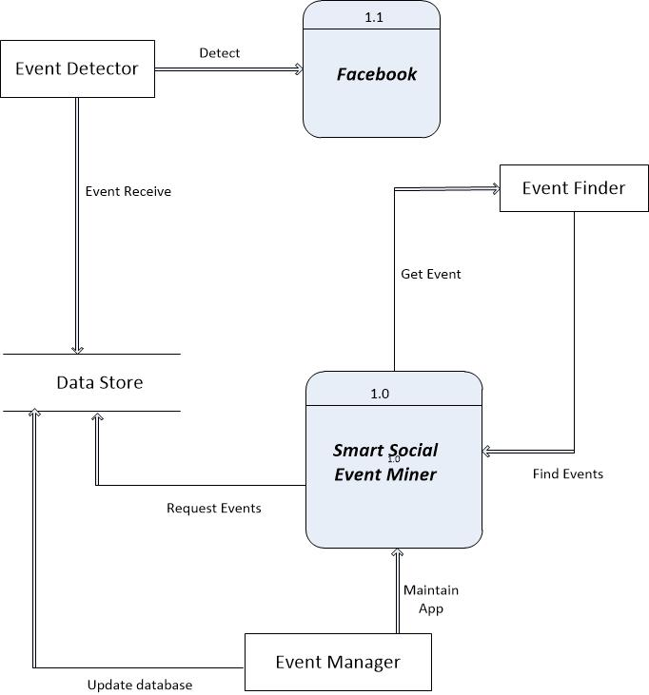
Continue… 1 level

Slide 18
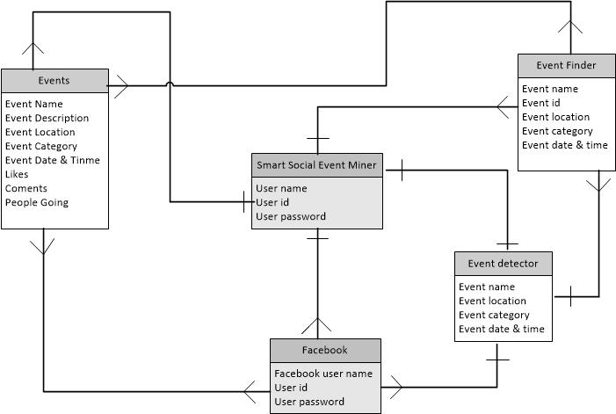
Entity Relationship Diagram (ERD)

Slide 19
Demonstration

Slide 20


Slide 21


